Slide 1
Measures of Central Tendency
Measure Of Central Tendency. Values that describe the central (middle) characteristics of data.
Mean (Average). The sum of data entries, divided by the number of entries.
Median. The middle value of a data set, when the data is arranged in ascending order.
Mode. The data entry(s) that occur(s) the most frequently.
Notes:
Measures of Central Tendency are measures which describe and locate the center values of the data. The 3 main measures of CT are Mean, Median, and Mode.

Slide 2
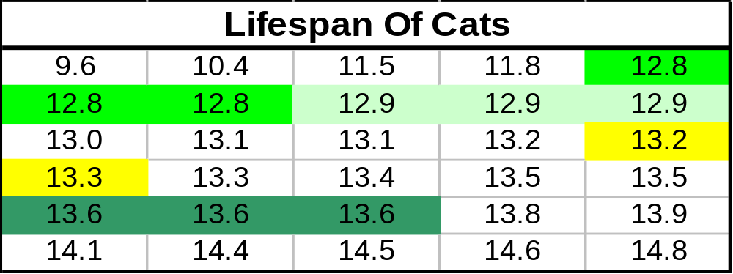
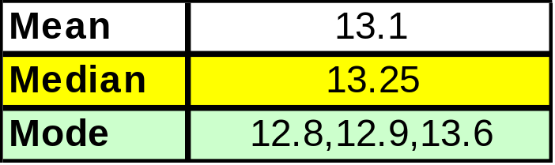
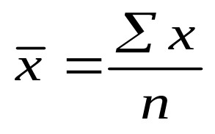
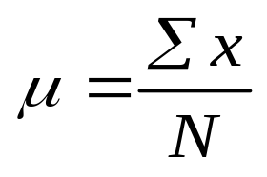
Measures Of Central Tendency
Sample Mean:
Population Mean:
Notes:
A study on the lifespan of cats took a random sampling of the age of 30 cats.
Median - If the data has an even number of entries, the median is the average of the two middle data entries, which in this case is the middle of 13.2 and 13.3.
Mode - In this case 3 entries define the mode. If the case that there are no repeating entries, there is no mode. In the case that that there is more than one mode, the data is bimodal.

Slide 3
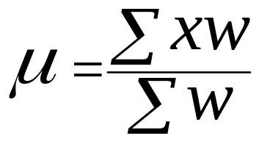
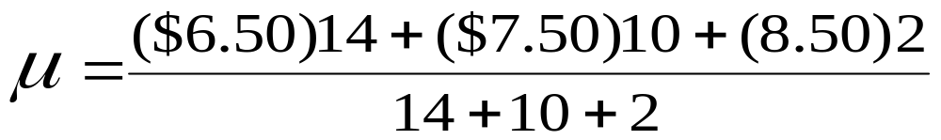
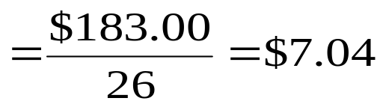
Weighted Mean Example
A company has 26 trainees. 14 are paid at the rate of $6.50/hour, 10 at $7.50/hour, and 2 at $8.50/hour. What is the average hourly rate for trainees?
Create Histogram
Median = ?

Slide 4
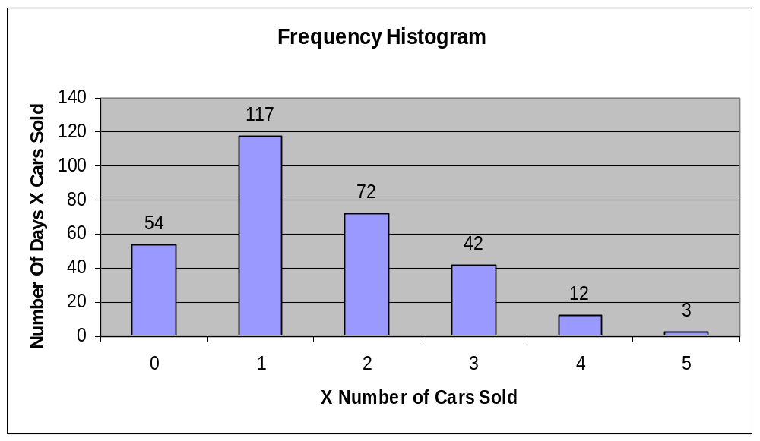
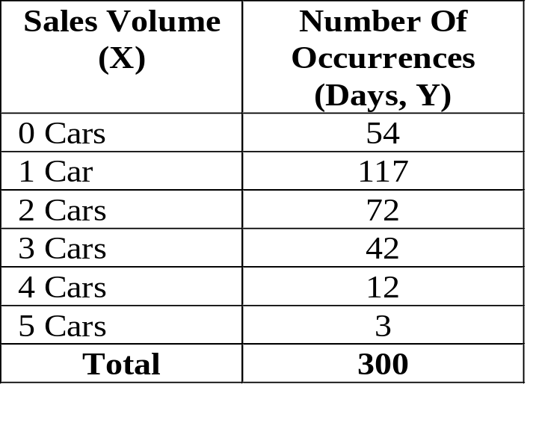
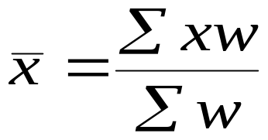
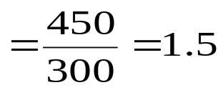
Weighted Mean Calculations
Median = ?
Notes:
Notice that the median here is 1. Spread the numbers out sequentially.

Slide 5
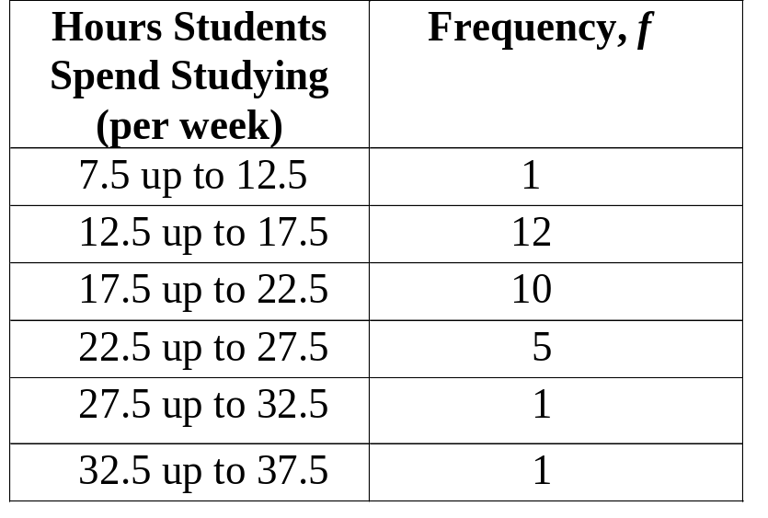
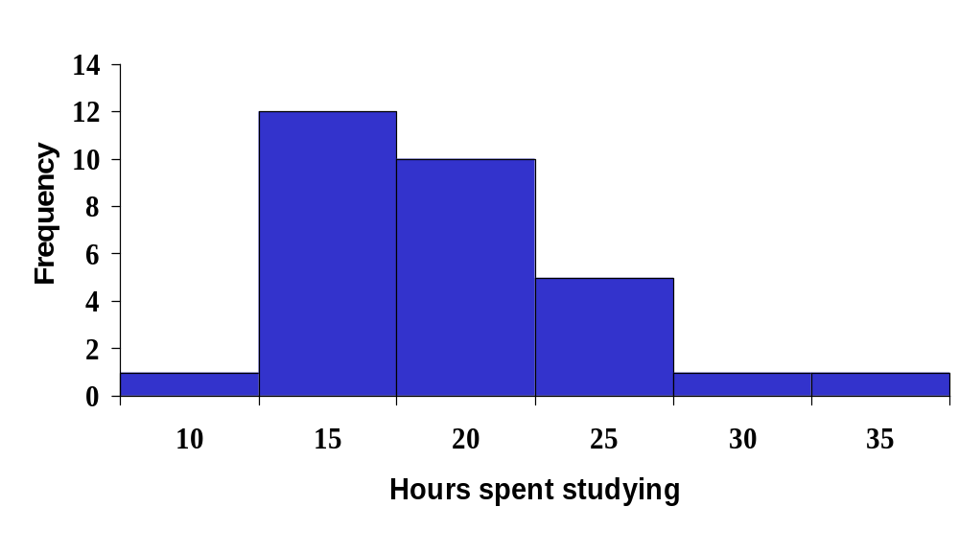
Notes:
There are 30 students total for this example.

Slide 6
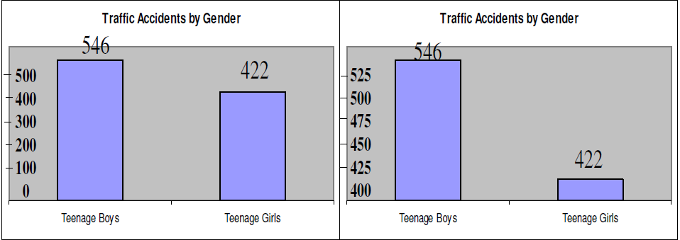
Inappropriate Use of Statistics
Zero Starting Points

Slide 7
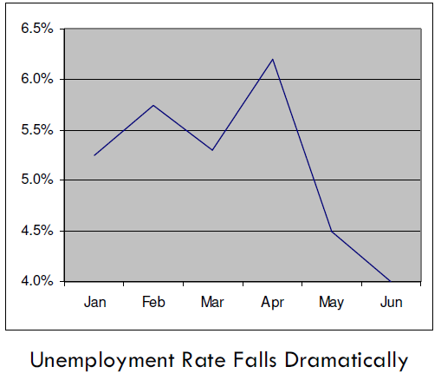
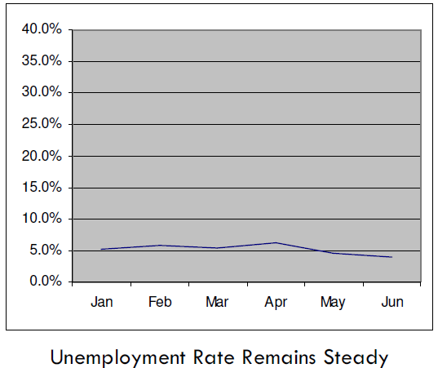
Inappropriate Use of Statistics
Scale Differences

Slide 8
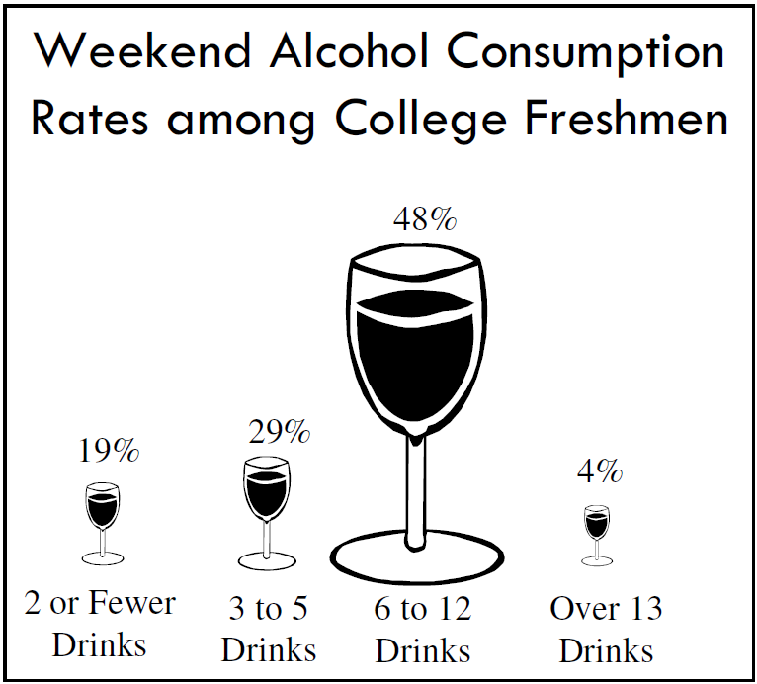
Inappropriate Use of Statistics
Volume Distortions

Slide 9
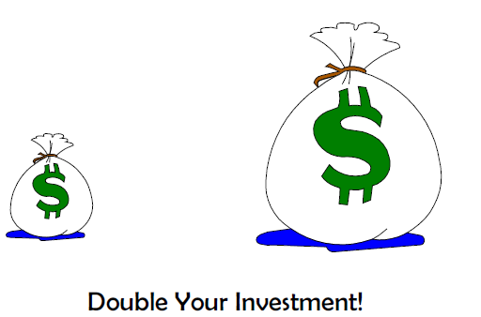
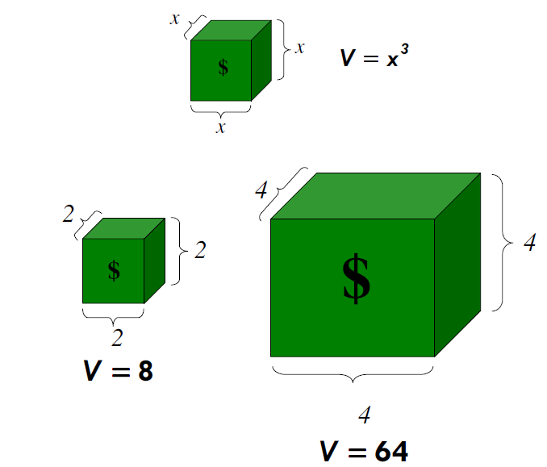
Inappropriate Use of Statistics
Volume Distortions
Increasing the length by 2 increases the volume by 8.

Slide 10

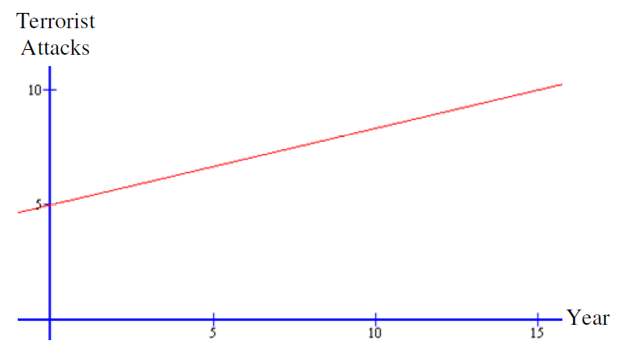
Inappropriate Use of Statistics
Wording Distortions

Slide 11
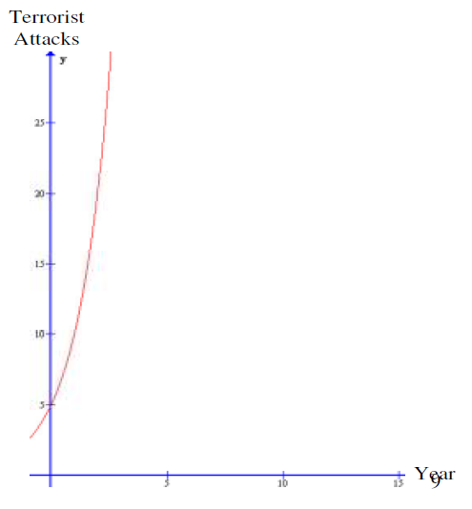
Be careful how you read and listen. A slight change in wording changes the outcome massively.

